Slide 1

CHAPTER 6 Inventories

Slide 2

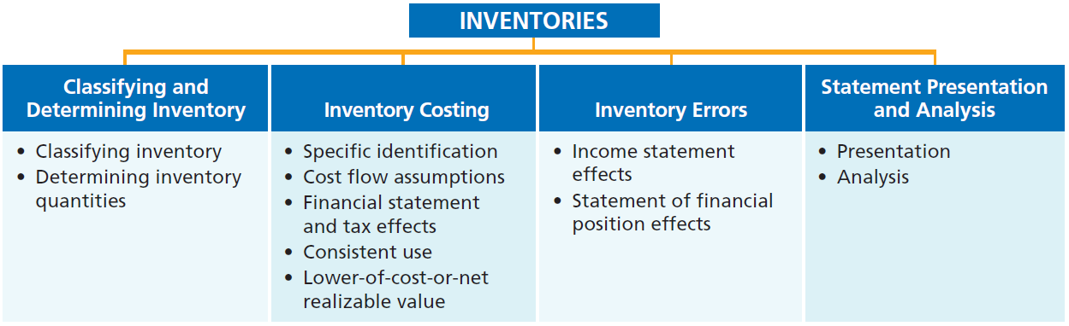
PREVIEW OF CHAPTER 6

Slide 3
Classifying and Determining Inventory
(See p. 278)
Classifying Inventory存貨類型
Merchandising Company
Manufacturing Company
One Classification:
Inventory
Three Classifications:
Raw Materials(原料)
Work in Process(在製品)
Finished Goods(製成品)
• HELPFUL HINT
Regardless of the classification, companies report all inventories under Current Assets on the statement of financial position.

Slide 4
Determining Inventory Quantities
(See p. 279)
Physical Inventory (盤點存貨)taken for two reasons:
Perpetual System(永續盤存制）
Check accuracy of inventory records(存貨記錄的正確性).
Determine amount of inventory lost(存貨損失金額) due to wasted raw materials, shoplifting(偷竊), or employee theft.
Periodic System(定期盤存制)
Determine the inventory on hand(庫存存貨).
Determine the cost of goods sold for the period.

Slide 5
Determining Inventory Quantities
(See p. 279)
Two steps of Determining Inventory Quantities
Taking a physical inventory of goods on hand(實地盤點庫存存貨).
Determining the ownership of goods(判斷商品所有權).

Slide 6
Taking A Physical Inventory
(See p. 279)
Involves counting, weighing, or measuring each kind of inventory on hand.
Companies often “take inventory(盤點存貨)”.
The business is closed or business is slow (淡季).
The end of the accounting period.

Slide 7
Determining Ownership Of Goods
(See p. 280)
GOODS IN TRANSIT在途存貨
Purchased goods that have not yet been received.
Sold goods that have not yet been delivered.
Goods in transit should be included in the inventory of the company that has legal title (法定所有權)to the goods. Legal title is determined by the terms of sale(銷貨條件).

Slide 8
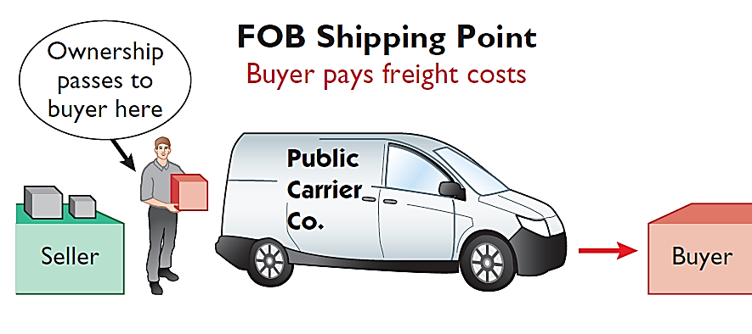
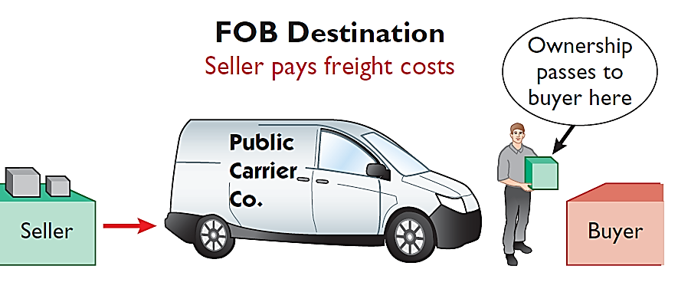
Determining Ownership Of Goods
(See p. 280)
Illustration 6-2 Terms of sale
Ownership of the goods passes to the buyer when the public carrier accepts the goods from the seller.
Ownership of the goods remains with the seller until the goods reach the buyer.

Slide 9
Determining Ownership of Goods
(See p. 281)
Consigned Goods寄銷品
Hold the goods of other parties(其他企業).
Try to sell the goods for them for a fee.
Not take ownership of the goods.

Slide 10
>
DO IT!
(See p. 282)
Deng Yaping Company completed its inventory count. It arrived at a total inventory value of ¥200,000. You have been given the information listed below. Discuss how this information affects the reported cost of inventory.
1. Deng Yaping included in the inventory goods held on consignment for Falls Co., costing ¥15,000.
2. The company did not include in the count purchased goods of ¥10,000, which were in transit (terms: FOB shipping point).
3. The company did not include in the count inventory that had been sold with a cost of ¥12,000, which was in transit (terms: FOB shipping point).
Solution
Inventory should be ¥195,000 (¥200,000 - ¥15,000 + ¥10,000).
Related exercise material : E6-1; E6-2; P6-1a

Slide 11
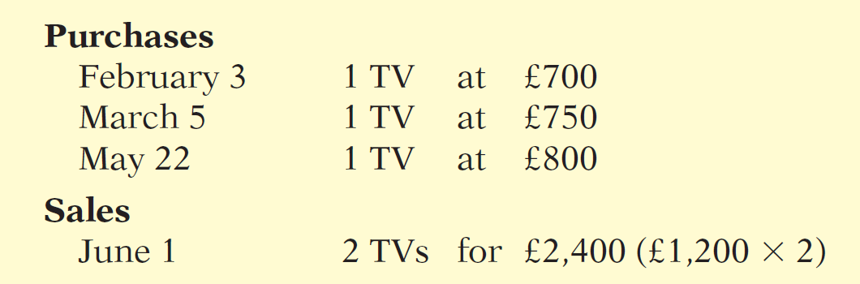
Inventory Costing
(See p. 282)
Inventory is accounted for at cost.
Unit costs are applied to the quantities to compute the total cost of the inventory and the cost of goods sold using the following costing methods:
Illustration 6-3

Slide 12
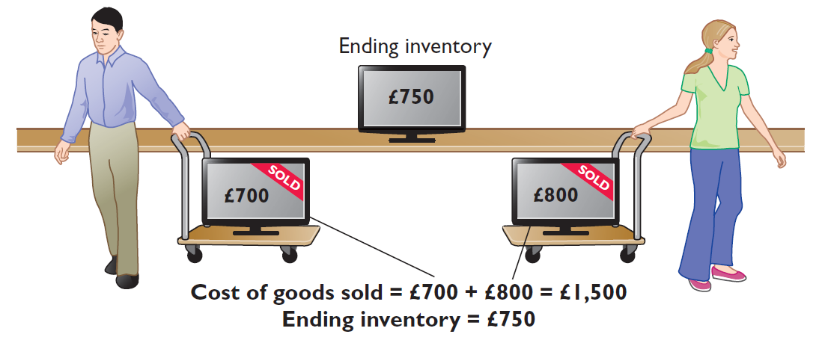
Specific Identification個別認定法
(See p. 283)
If Crivitz sold the TVs it purchased on February 3 and May 22, then its cost of goods sold is £1,500 (£700 + £800), and its ending inventory is £750.
Illustration 6-4
Specific identification method

Slide 13
Cost Flow Assumptions成本流動假說
(See p. 283)
Assume cost flow may be unrelated to the physical flow of the goods.
There are two assumed cost flow methods:
First-in, first-out (FIFO)先進先出法
Average-cost平均成本法

Slide 14
Cost Flow Assumptions成本流動假說
(See p. 284)
A periodic inventory system(定期盤存制) is used to demonstrate two methods because very few companies use perpetual FIFO or average-cost.
The cost of goods sold formula in a periodic system is:
(Beginning Inventory + Purchases) - Ending Inventory = Cost of Goods Sold
Cost of goods available for sale
(可供銷售商品成本)

Slide 15
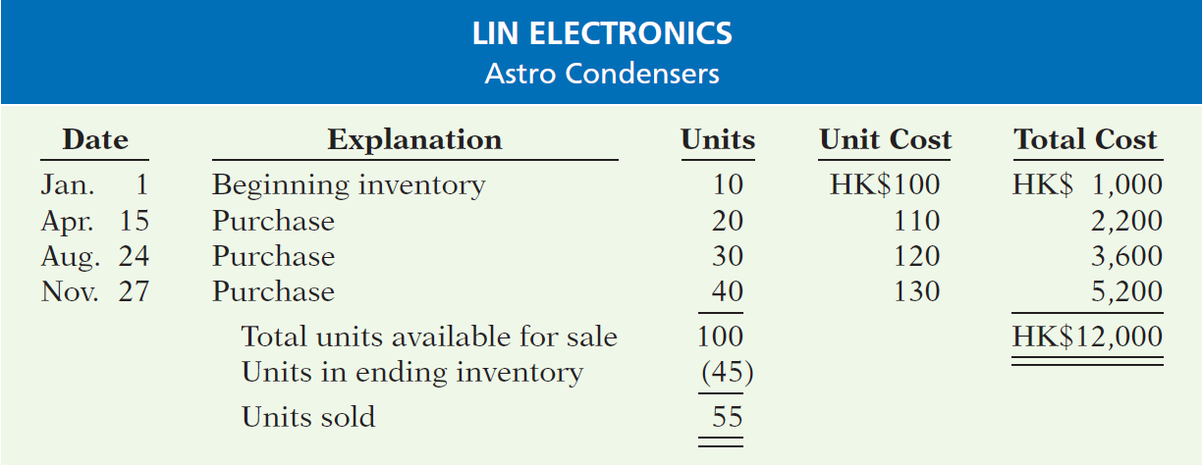
Cost Flow Assumptions成本流動假說
(See p. 284)
Data for Lin Electronics’ Astro condensers.
Illustration 6-5

Slide 16
FIRST-IN, FIRST-OUT (FIFO)先進先出
(See p. 284)
The earliest goods purchased are the first to be sold.
Often parallels(相似) actual physical flow of merchandise.
Companies obtain the cost of the ending inventory by taking the unit cost of the most recent purchase and working backward until all units of inventory have been costed (期末存貨成本是以最近進貨的單位成本往前推，直到每個存貨成本都被算進去為止).

Slide 17
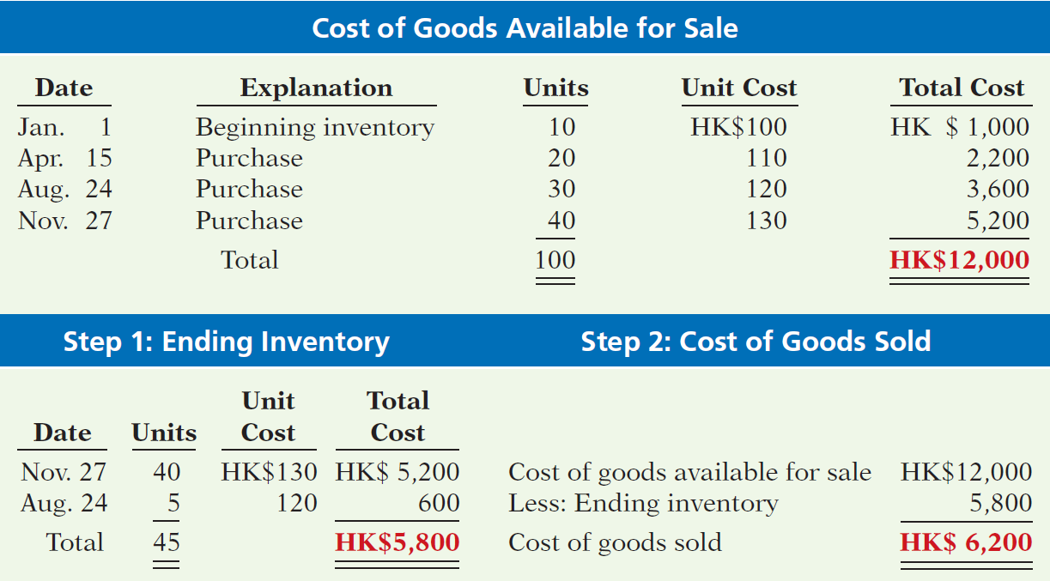
FIRST-IN, FIRST-OUT (FIFO)先進先出
(See p. 285)
Illustration 6-6
Allocation of costs—FIFO method

Slide 18
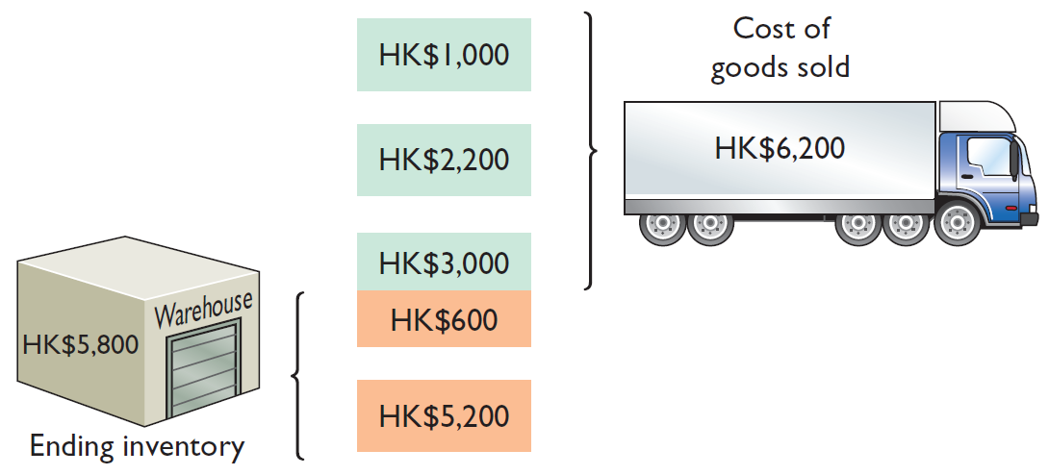
FIRST-IN, FIRST-OUT (FIFO)先進先出
(See p. 285)
Illustration 6-6
Allocation of costs—FIFO method

Slide 19
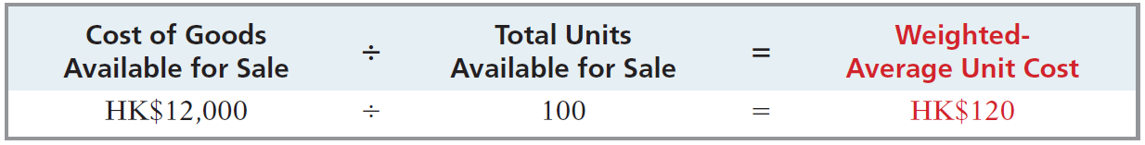
AVERAGE-COST平均成本
(See p. 286)
Allocates cost of goods available for sale on the basis of weighted-average unit cost(加權平均單位成本) incurred.
Applies weighted-average unit cost to the units on hand to determine cost of the ending inventory(將加權平均單位成本乘上庫存存貨以決定期末存貨成本).
Illustration 6-8
Formula for weighted-average unit cost

Slide 20
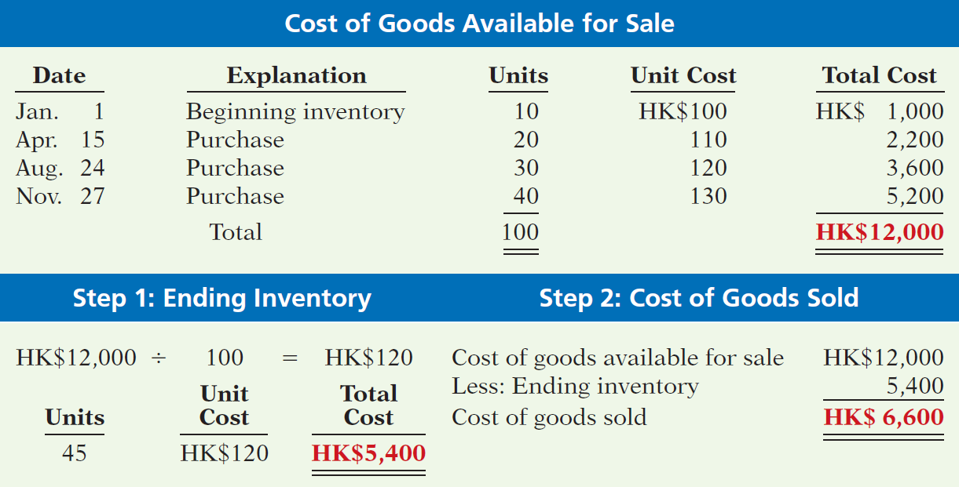
AVERAGE-COST平均成本
(See p. 286)
Illustration 6-9
Allocation of costs—average-cost method

Slide 21
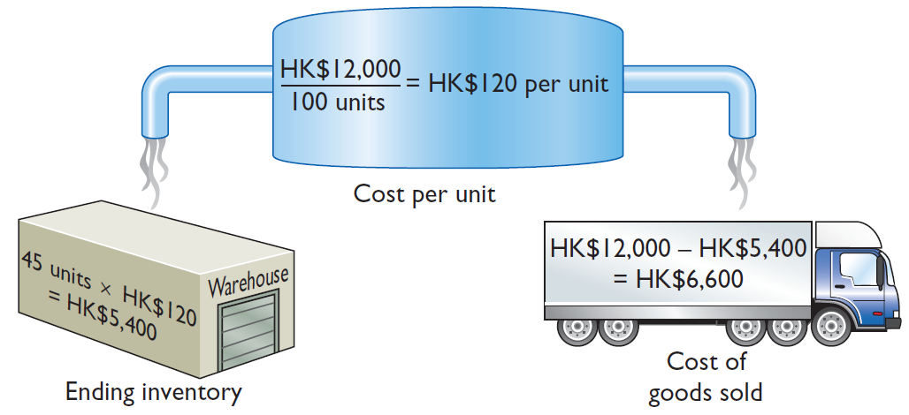
AVERAGE-COST平均成本
(See p. 286)
Illustration 6-9
Allocation of costs—average-cost method

Slide 22
>
DO IT!
(See p. 287)
The accounting records of Shumway Ag Implement show the following.
Beginning inventory 4,000 units at £ 3
Purchases 6,000 units at £ 4
Sales 7,000 units at £12
Determine the cost of goods sold during the period under a periodic inventory system using (a) the FIFO method and (b) the average-cost method.
Solution
Cost of goods available for sale = (4,000 × £3) + (6,000 × £4) = £36,000
Ending inventory = 10,000 − 7,000 = 3,000 units
(a) FIFO: £36,000 − (3,000 × £4) = £24,000
(b) Average cost per unit: [(4,000 × £3) + (6,000 × £4)] ÷ 10,000 = £3.60 Average-cost: £36,000 − (3,000 × £3.60) = £25,200
Related exercise material : E6-3~ E6-7; P6-2a~P6-7a

Slide 23
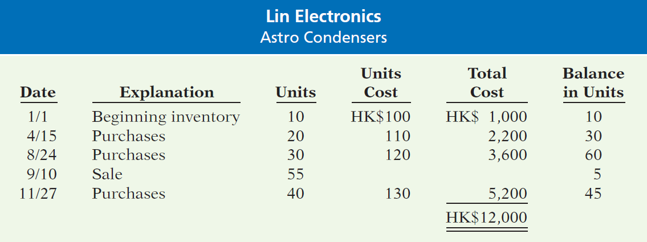
Appendix A Perpetual Inventory System
(See p. 294)
Assuming the Perpetual Inventory System, compute Cost of Goods Sold and Ending Inventory under FIFO and average-cost.
Illustration 6A-1
Inventoriable units and costs

Slide 24
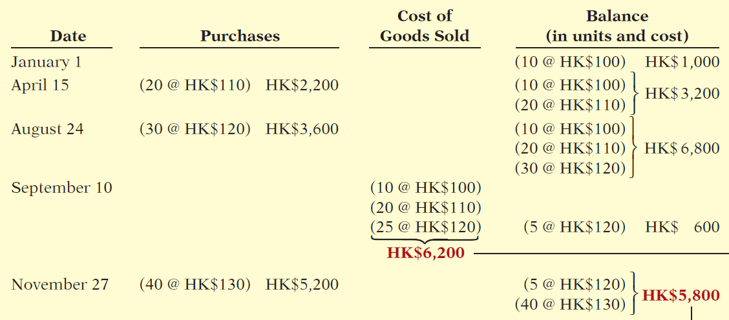
Appendix A Perpetual Inventory System
(See p. 295)
First-In-First-Out (FIFO)
Illustration 6A-2
Perpetual system—FIFO
Cost of Goods Sold
Ending Inventory

Slide 25
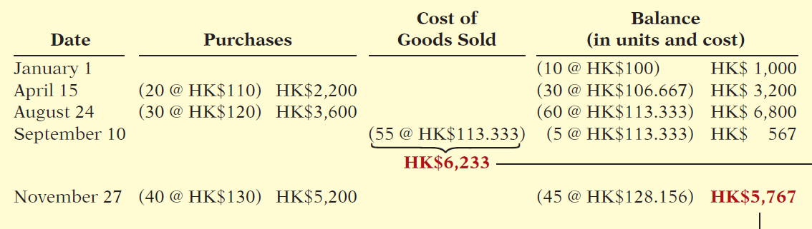
Appendix A Perpetual Inventory System
(See p. 295)
Average-Cost
Illustration 6A-3
Cost of Goods Sold
Ending Inventory
Related exercise material : E6-14; E6-15; P6-8a; P6-9a

Slide 26
P6-8
Dominican Appliance Mart began operations on May 1. It uses a perpetual inventory system. During May, the company had the following purchases and sales for its Model 25 Sureshot camera.
 |  | Purchases
Date |  | Units |  | Unit Cost |  | Sales Units
May 1 |  | 7 |  | NT$4,600
4 |  |  |  |  |  | 4
8 |  | 8 |  | NT$5,100
12 |  |  |  |  |  | 5
15 |  | 6 |  | NT$5,520
20 |  |  |  |  |  | 3
25 |  |  |  |  |  | 5
Determine the ending inventory under a perpetual inventory system using (1) FIFO and (2) moving-average cost.
(b) Determine the ending inventory under a periodic inventory system using (1) FIFO and (2) moving-average cost.

Slide 27
>
中文練習題
(杜榮瑞，第六版)
真好吃食品公司X8年10月1日有大腸臭臭鍋料理包存貨100包，每包成本為$20，10月份之進貨及銷貨資料如下：
試分別依定期盤存制與永續盤存制下之下列各方法求算真好吃食品公司X8年10月底之存貨 及X8年10月份銷貨成本金額：(1)個別認定法(10/8之銷貨全部為10/5之進貨 ，10/22之銷貨有100包為10/5之進貨，700包為10/14之進貨 )；(2) 先進先出法；(3)加權平均法。
 |  | 單位 | 單位成本
10/5 | 進貨 | 600 | $22
10/8 | 銷貨 | 500
10/14 | 進貨 | 700 | $24
10/22 | 銷貨 | 800
10/30 | 進貨 | 500 | $25

Slide 28
>
中文練習題
(杜榮瑞，第六版)
解析：
可供銷售商品數量=期初存貨+本期進貨=100+600+700+500=1,900
可供銷售商品成本=100*20+22*600+24*700+25*500=44,500
期末存貨數量=可供銷售商品數量-本期銷售數量
=1,900-(500+800)=600
(a)個別認定法
由於個別認定法是以商品實際流物情形做為銷貨成本與期末存貨成本之計算依據,故採用定期盤存制與永續盤存制結果相同。
銷貨成本＝500*22+100*22+700*24=30,000
期末存貨＝44,500-30,000=14,500

Slide 29
>
中文練習題
(杜榮瑞，第六版)
(b)先進先出法
定期盤存制
 |  | 單位 | 單位成本
10/1 | 存貨 | 100 | $20
10/5 | 進貨 | 600 | $22
10/14 | 進貨 | 700 | $24
10/30 | 進貨 | 500 | $25
期末存貨數量600
期末存貨＝500*25+100*24=14,900
銷貨成本＝44,500-14,900=29,600

Slide 30
>
中文練習題
(杜榮瑞，第六版)
(b)先進先出法
永續盤存制
 |  | 單位 | 單位成本
10/1 | 存貨 | 100 | $20
10/5 | 進貨 | 600 | $22
10/14 | 進貨 | 700 | $24
10/30 | 進貨 | 500 | $25
本期銷售數量
1,300
銷貨成本＝100*20+600*22+(1,300-100-600)*24=29,600
期末存貨＝44,500-29,600=14,900
注意：先進先出法下，無論公司採永續盤存制或定期盤存制，銷貨成本與期末存貨成本的金額並無不同。

Slide 31
>
中文練習題
(杜榮瑞，第六版)
(C)加權平均法
定期盤存制
此制度下加權平均法,係以本期可供銷售商本成本除以可供銷售商品數量得出平均單位成本。
平均單位成本＝44,500/1,900=23.42
期末存貨＝600*23.42=14,052
銷貨成本＝44,500-14,052=30,448

Slide 32
>
中文練習題
(杜榮瑞，第六版)
(C)加權平均法
永續盤存制
此制度下加權平均法又稱為移動平均法,每次進貨發生，則將本次進貨成本與上次進貨結存混合，重新計算加權平均成本，作為下次銷貨成本之計算基礎。
 |  | 單位 | 單位成本 | 結存數量 | 結存餘額 | 平均成本
10/1 | 存貨 | 100 | $20
10/5 | 進貨 | 600 | $22 | 700 | 15,200 | 21.71
10/8 | 銷貨 | 500 |  | 200 | 4,345 | 21.71
10/14 | 進貨 | 700 | $24 | 900 | 21,145 | 23.49
10/22 | 銷貨 | 800
銷貨成本＝500*21.72+800*23.49=29,652
期末存貨＝44,500-29,652==14,848

Slide 33
Financial Statement and Tax Effects of Cost Flow Methods 成本流動方法對財報與稅負的影響
Either of the two cost flow assumptions is acceptable for use.
Adopting the specific assumptions involves the following factors:
Income statement effects
Statement of financial position effects
Tax effects

Slide 34
Income Statement Effects
(See p. 284)
Data for Lin Electronics’ Astro condensers.
Illustration 6-5
價格上升

Slide 35
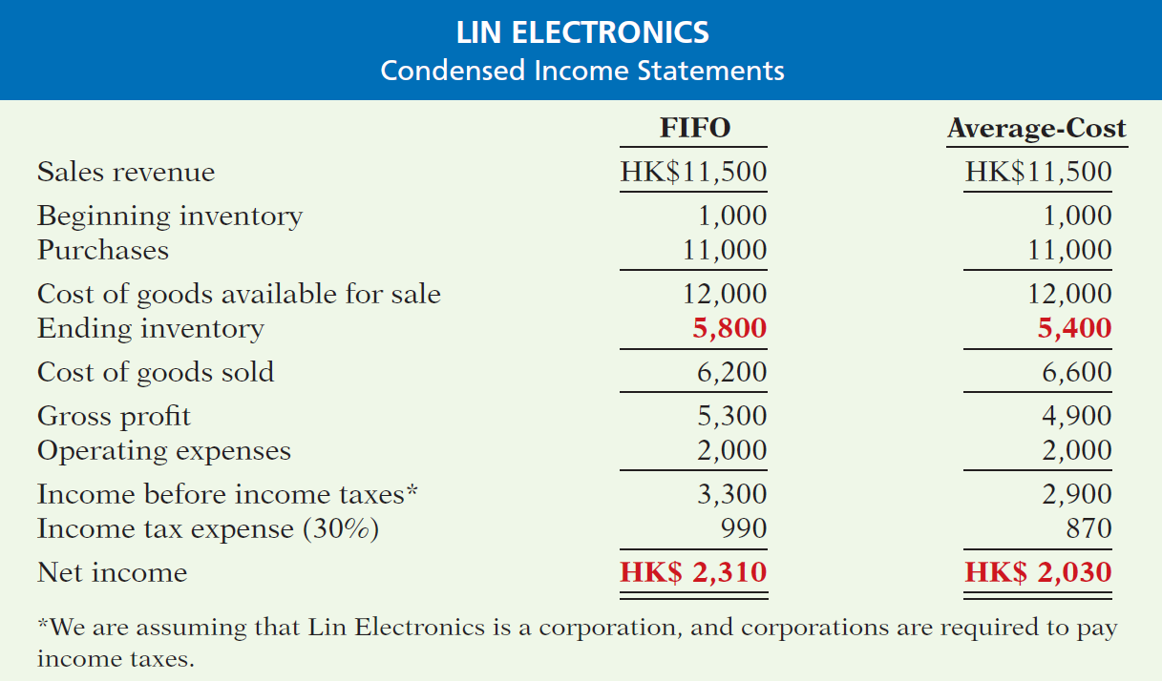
Income Statement Effects
(See p. 288)
Illustration 6-10
Comparative effects of cost flow methods
期初存貨
進貨
可供銷售商品成本
期末存貨
銷貨成本
$400
銷貨毛利
稅前淨利
$400
所得稅費用
淨利

Slide 36
Income Statement Effects
(See p. 289)
In periods of changing prices, the cost flow assumption can have a significant impact on income.
In a period of rising price, FIFO produces a higher net income because the lower unit costs of the first units purchased are matched against revenues.
If prices are falling(價格下降), the results from the use of FIFO and average-cost are reversed.

Slide 37
Statement Of Financial Position Effects
(See p. 289)
A major advantage of the FIFO method
In a period of inflation(通貨膨脹期間), the costs allocated to ending inventory will approximate their current cost(現時成本).
A major shortcoming of the average-cost method
In a period of inflation, the costs allocated to ending inventory may be understated in terms of current cost.

Slide 38
Tax Effects對稅負的影響
(See p. 289)
During times of rising prices, Average-cost results in the lower income taxes (because of lower income before income taxes).
400
120

Slide 39
Using Cost Flow Methods Consistently
採用成本流動方法之一致性
(See pp. 288~9)
consistency concept (一致性觀念)
A company uses the same accounting principles and methods from year to year.
Enhances the comparability of financial statements over successive(連續) time period.
If a company change its method, it should disclose in the financial statements the change and its effects on net income.

Slide 40
Lower-of-Cost-or-Net Realizable Value
成本與淨變現價值孰低法
(See p. 289)
An example of the accounting concept of prudence(審慎性會計觀念)
The best choice among accounting alternatives is the method that is least likely to overstate assets and net income.

Slide 41
Lower-of-Cost-or-Net Realizable Value
成本與淨變現價值孰低法
(See p. 289)
When the value of inventory is lower than its cost, companies must “write down” the inventory to its net realizable value(淨變現價值).
The definition of Net realizable value
Net amount that a company expects to realize (receive) from the sale of inventory.
The estimated selling price in the normal course of business less estimated costs to complete and sell.

Slide 42
Lower-of-Cost-or-Net Realizable Value
成本與淨變現價值孰低法
補充說明(杜榮瑞，第六版)
資產負債表中的存貨金額應以成本與淨變現價值兩者孰低的金額表達之。
當成本低於淨變現價值時，存貨以成本金額記錄，等未來出售實再認列利益。
當成本高於淨變現價值時，存貨記錄金額應由原來的成本減至淨變現價值，這樣未來出才不會有損失。

Slide 43
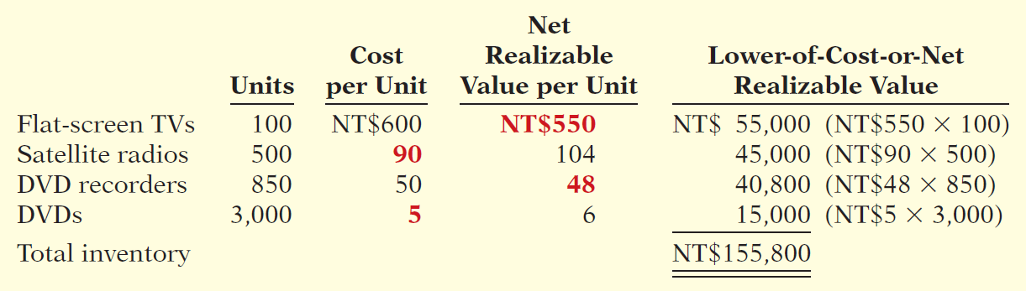
Lower-of-Cost-or-Net Realizable Value
成本與淨變現價值孰低法
(See p. 290)
Illustration: Assume that Gao TV has the following lines of merchandise with costs and market values as indicated.
Illustration 6-11
Computation of lower-of-cost-or-net realizable value
Related exercise material : E6-8; E6-9

Slide 44
Inventory Errors
(See p. 290)
Common Causes:
Failure to count or price inventory correctly.
Not properly recognizing the transfer of legal title (法定所有權)to goods in transit.
Errors affect both the income statement and statement of financial position.

Slide 45
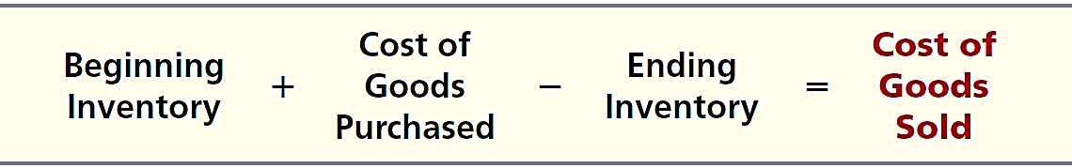
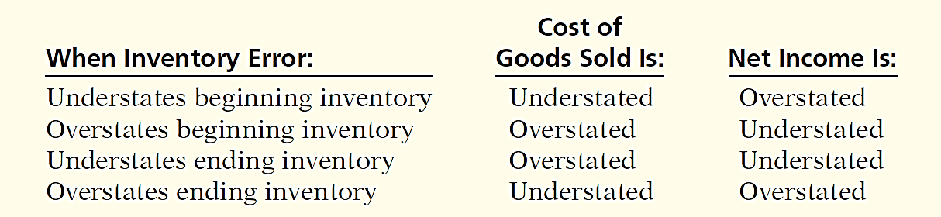
Income Statement Effects
(See p. 290)
Inventory errors affect the computation of cost of goods sold and net income in two periods.
Illustration 6-12
Formula for cost of goods sold
Illustration 6-13
Effects of inventory errors on current year’s income statement

Slide 46
Income Statement Effects
(See pp. 291)
Illustration 6-14
Effects of inventory errors on two years’ income statements
Combined income for
2-year period is correct.
(€3,000)
Net income understated
€3,000
Net income overstated

Slide 47
Income Statement Effects
(See pp. 291)
An error in ending inventory of the current period will have a reverse effect on net income of the next accounting period.
Over the two periods, the total net income is correct because the errors offset each other.

Slide 48
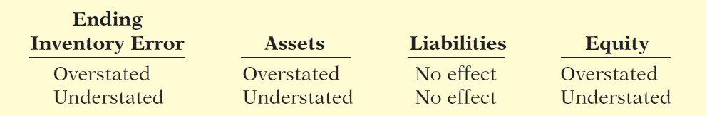
Statement of Financial Position Effects
(See pp. 291)
Effect of inventory errors on the statement of financial position is determined by using the basic accounting equation: Assets = Liabilities + Equity.
Errors in the ending inventory have the following effects.
Illustration 6-15
Effects of ending inventory errors on statement of financial position
Total equity in next period will be correct.

Slide 49
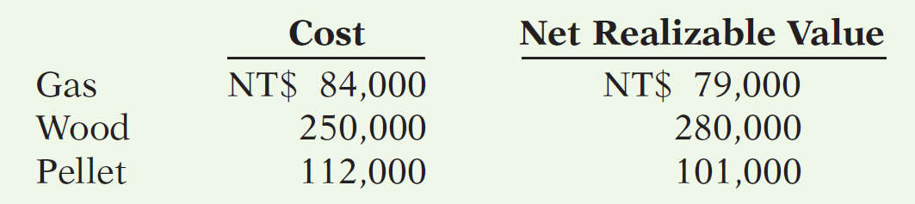
>
DO IT!
(See pp. 292)
LCNRV Basis; Inventory Errors
(a) Tracy Company sells three different types of home heating stoves (wood, gas, and pellet). The cost and net realizable value of its inventory of stoves are as follows.
Determine the value of the company’s inventory under the lower-of-cost-or-net realizable value approach.
Total inventory value is the sum of these amounts, NT$430,000.

Slide 50
>
DO IT!
(See pp. 292)
LCNRV Basis; Inventory Errors
Visual Company overstated its 2016 ending inventory by NT$22,000. Determine the impact this error has on ending inventory, cost of goods sold, and equity in 2016 and 2017.
2016
2017
Ending inventory NT$22,000 overstated No effect
Cost of goods sold NT$22,000 understated NT$22,000 overstated
Equity NT$22,000 overstated No effect
Ending inventory
Cost of goods sold
Equity
Related exercise material : E6-10;E6-11

Slide 51
Statement Presentation and Analysis
(See pp. 292)
Presentation
Statement of Financial Position - Inventory classified as current asset.
Income Statement - Cost of goods sold is subtracted from sales.
There also should be disclosure of the
major inventory classifications,
basis of accounting (cost or LCNRV), and
costing method (specific identification, FIFO, or average-cost).

